Slide 1


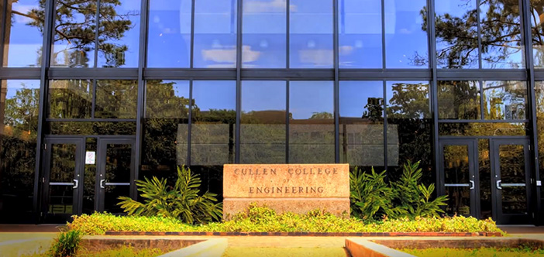

Predicting Rate of Penetration in Underbalanced Drilling Using Machine Learning
Nathan Tran
Notes:
Thank you for your attention. My name is Nathan Tran. I will be talking about the impact of numerical dispersion on simulation results.

Slide 2

Summary
Discussion Topics
Value of predicting ROP and machine learning in oil and gas business
Data exploration
Predictive model development
Conclusions
Key Messages
Exploring the data is an important step before developing any model.
In this particular underbalanced drilling process, GR is the most important parameter for any cluster.
The predictive model derived by random forest (RF) generate reasonable forecasts for ROP.
Desired Outcomes
The completion of Project’s deliverable
Feedback from Dr. Robello and classmates for lessons learn and future improvement

Slide 3
Introduction
Underbalance drilling has the advantage to minimize formation damage, lost circulation and differential sticking.
Predicting rate of penetration (ROP) is important because it is a useful parameter for optimizing drilling cost which is usually expensive for underbalanced drilling.
In situations where data is large enough and relevant to answer the question, machine learning algorithms can be used to predict ROP.
Machine Learning has the advantage of performing quick calculations and automated procedures.
Tool/Technique: XLSTAT/Random Forest Regression
Notes:
Random forests or random decision forests are an ensemble learning method for classification, regression and other tasks, that operate by constructing a multitude of decision trees at training time and outputting the class that is the mode of the classes (classification) or mean prediction (regression) of the individual trees
A random forest is simply a collection of decision trees whose results are aggregated into one final result. Their ability to limit overfitting without substantially increasing error due to bias is why they are such powerful models. One way Random Forests reduce variance is by training on different samples of the data

Slide 4
Data Description and Exploration
Data includes 13 operational parameters with over 3700 data samples collected from an underbalanced drilling process in Ekofisk formation.
Parameters | Category
MWout | Operational
TempMudin | Operational
BlockPos | Operational
HookLoadA | Operational
WOBA | Operational
RPMA | Operational
TorqueAbs | Operational
Pressure | Operational
Flowin | Operational
HookLoad | Operational
Depth | Formation Property
Time | Operational
GR | Formation Property
Directly applying Random Forest (RF) to regress the targeted variable results in inaccurate predictions

Slide 5
Data Clustering
Two groups of GR values affecting ROP differently. These two groups (GR < 30 and GR >= 30) need to be modeled differently to generate a better regression.

Slide 6
Data Clustering
Within GR < 30 group, MWout follows two different trends (MWout > 6.6 and MWout >= 6.6). These two trends need to be modeled differently to generate a better regression.

Slide 7
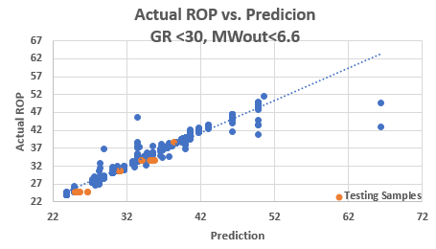
Random Forest Regression for Cluster 1: GR < 30, MWout < 6.6

Slide 8
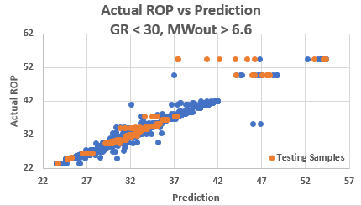
Random Forest Regression for Cluster 2: GR < 30, MWout > 6.6

Slide 9
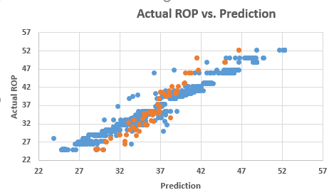
Random Forest Regression for Cluster 3: GR > 30

Slide 10
Conclusions
Exploring the data is an important step before developing any model. In this study, reviewing the data helps identify three major clusters (GR < 30 and MWout < 6.6, GR < 30 and MWout > 6.6, and GR > 30).
RF is a suitable machine learning technique for data sets with numerous samples. Each cluster has at least 700 samples. Therefore, RF can learn from samples to generate accurate predictions.
In this particular underbalanced drilling process, GR is the most important parameter for any cluster.
Assumptions: the formation is Ekofisk, ECD at the bottom and bit equals 8.3 ppg, MWin is as constant as 8.6 throughout the drilling process and bit size is 17.5 inches. The entire data set is from a single well.
Desired data for future :Data from other wells may be necessary to address the variability of ECD, MWin and bit size, drilling mud’s rhedology, bit types and rock’s mechanical properties may also the important parameters.

Slide 11
Acknowledgement
The presenter would like to kindly thank Dr. Samuel Robello for providing an excellent data set and his guidance to make this research possible.
The presenter also respectfully thanks University of Houston’s Central of Advanced Computing and Data Science for providing training in machine learning.

Slide 12
References
1. Bell, Jason. Machine Learning Hands-on for Developers and technical Professionals. Indianapolis: John Wiley & Sons, 2015.
2. Robello, Samuel. 501 Solved Problems for Drilling Operations, SigmaQuadrant.com, 2008

Slide 13
Q&A
Thank You!

